Slide 1


Stock Prediction : Question: How can I predict the stock price of a company using LSTM in a Jupyter notebook?
Kunal Salunkhe

Slide 2
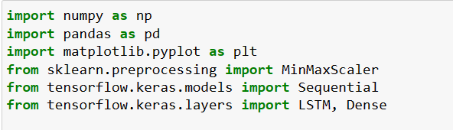
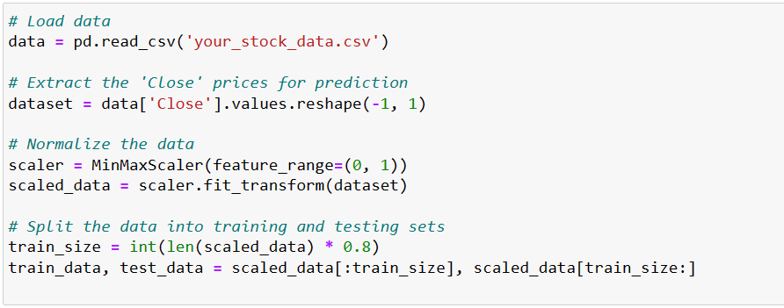
Kunal Salunkhe
Step 1: Import Libraries
Step 2: Load and Preprocess Data
Assuming you have a CSV file with historical stock data:

Slide 3
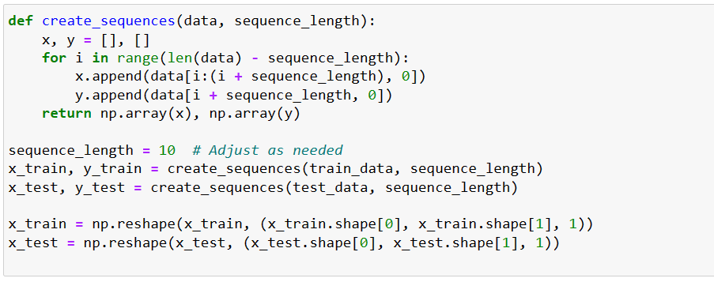
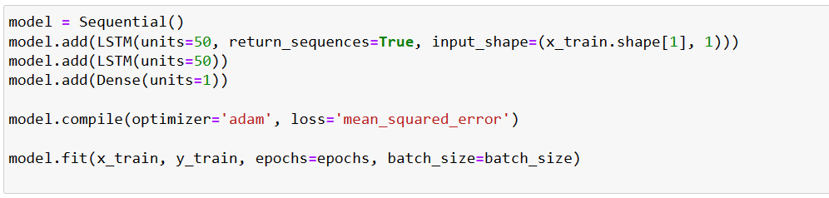
Step 3: Create Sequences for LSTM
Kunal Salunkhe
Step 4: Build and Train LSTM Model

Slide 4
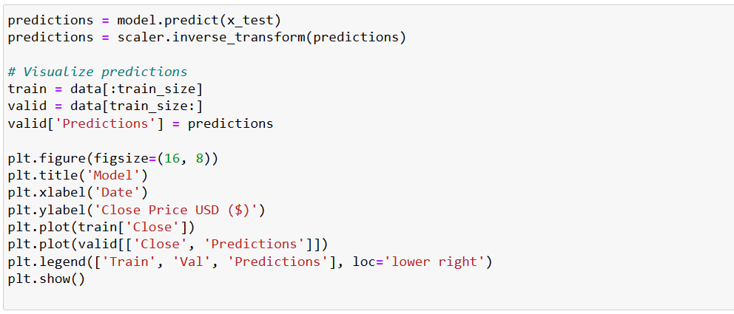
Kunal Salunkhe
Step 5: Make Predictions

Slide 5
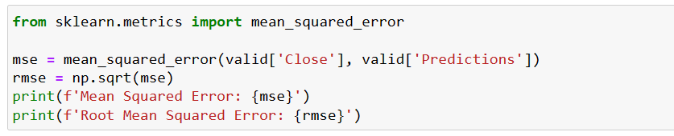
Kunal Salunkhe
Step 6: Evaluate the Model
Thank You..!! ☺

